Slide 1
Keras and basics of Deep Learning

Slide 2
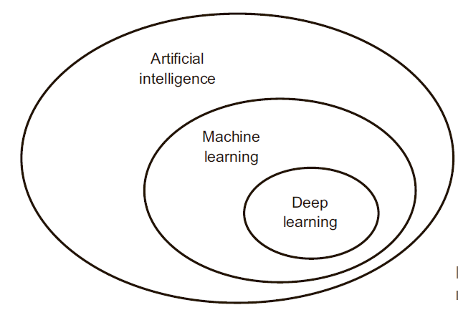
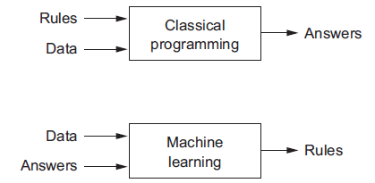
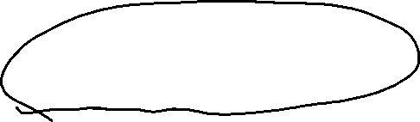

Slide 3
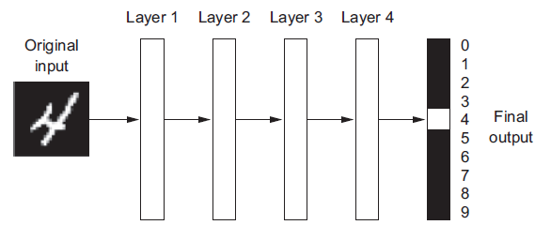

Slide 4
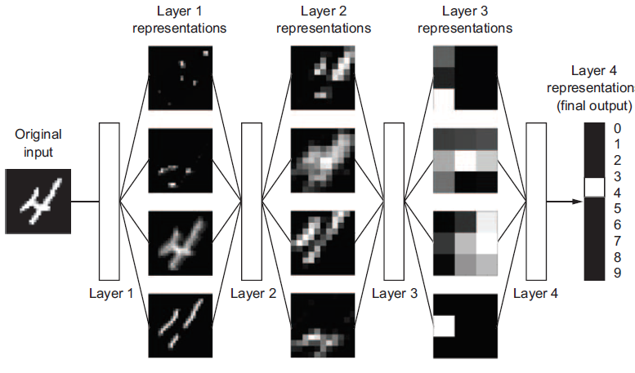

Slide 5
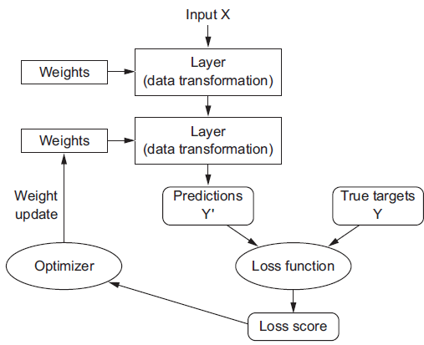

Slide 6
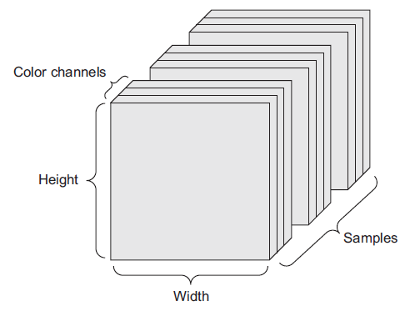
Data representation as tensors
Image Data

Slide 7
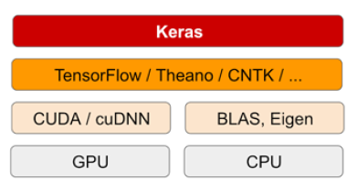
Keras Library

Slide 8
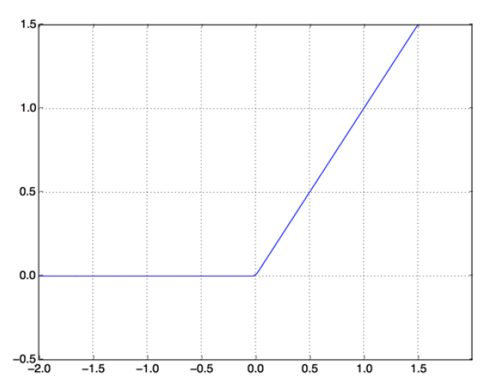
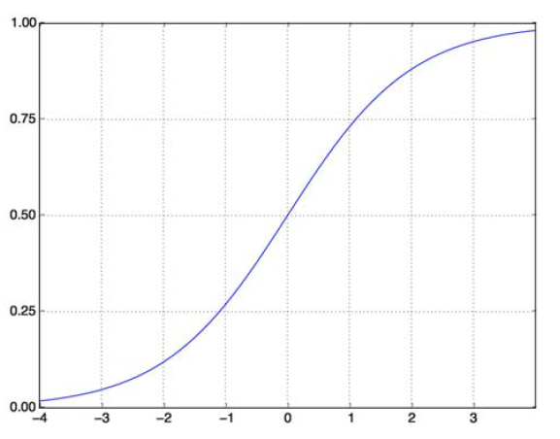
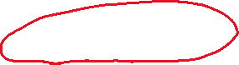

Activation functions
RELU
Sigmoid function

Slide 9
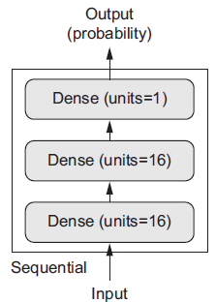
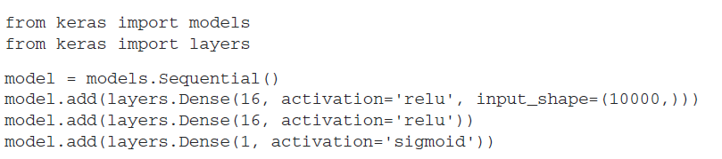
Example. Three-layer network
Example: movie reviews

Slide 10
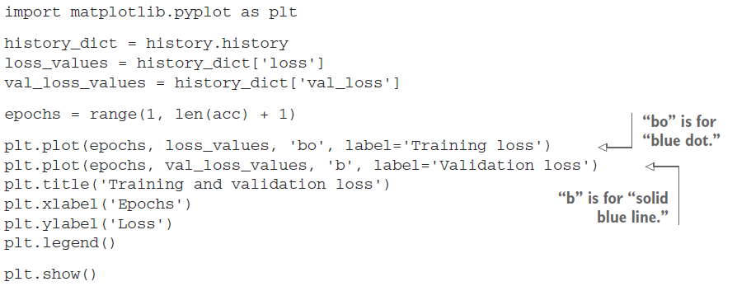
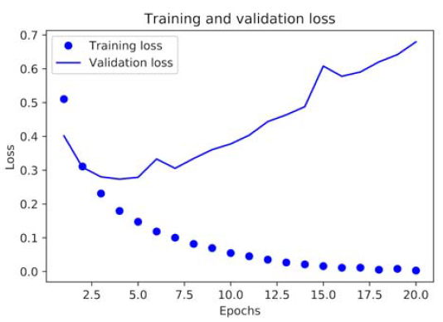
Plotting training and validation loss

Slide 11
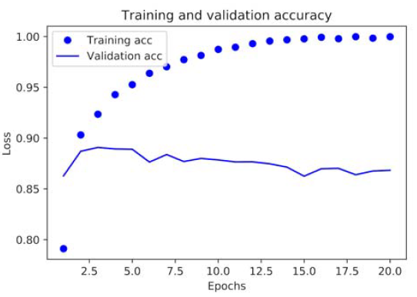
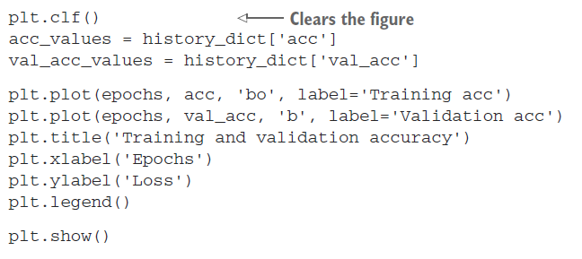
Training and validation accuracy

Slide 12
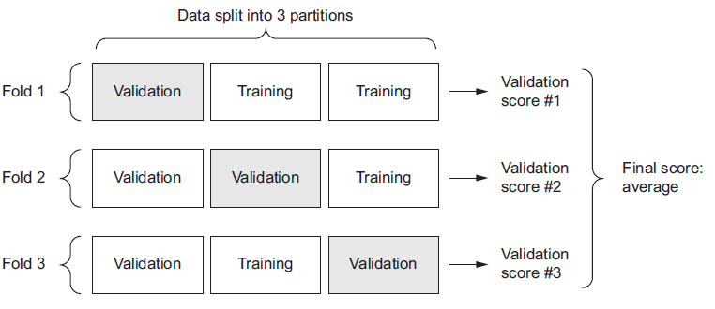
K-fold cross-validation
Example: regression problem

Slide 13
Data preprocessing
Vectorization
Normalization
Handling missing values (skikit Imputer class)
Data augumentation

Slide 14
Data preprocessing. Vectorization
All inputs and targets in a neural network must be tensors of floating-point data (or, in specific cases, tensors of integers). Whatever data you need to process—sound, images, text—you must first turn into tensors, a step called data vectorization.
Example: one-hot-encoding, word2vec

Slide 15
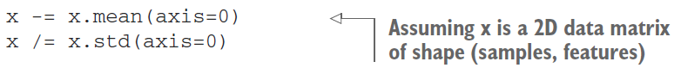
Data preprocessing. Value normalization
You have to normalize each feature independently so that it had a standard deviation of 1 and a mean of 0.
In general, it isn’t safe to feed into a neural network data that takes relatively large values (for example, multidigit integers, which are much larger than the initial values taken by the weights of a network) or data that is heterogeneous (for example, data where one feature is in the range 0–1 and another is in the range 100–200). Doing so can trigger large gradient updates that will prevent the network from converging. To make learning easier for your network, your data should have the following characteristics:
Take small values—Typically, most values should be in the 0–1 range.
Be homogenous—That is, all features should take values in roughly the same range.

Slide 16
Data preprocessing. Missing values
In general, with neural networks, it’s safe to input missing values as 0, with the condition that 0 isn’t already a meaningful value. The network will learn from exposure to the data that the value 0 means missing data and will start ignoring the value.
Note that if you’re expecting missing values in the test data, but the network was trained on data without any missing values, the network won’t have learned to ignore missing values! In this situation, you should artificially generate training samples with missing entries: copy some training samples several times, and drop some of the features that you expect are likely to be missing in the test data.

Slide 17
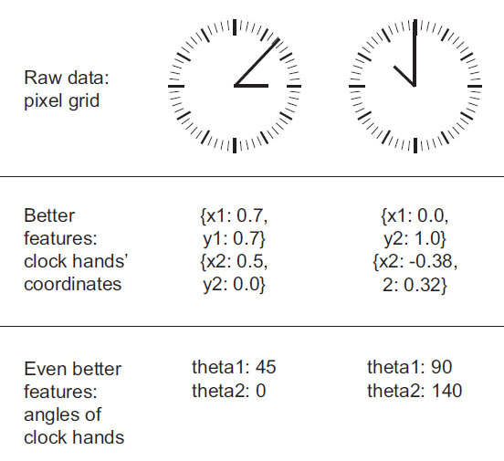
Feature engineering
Feature engineering is the process of using your own knowledge about the data and about the machine-learning algorithm at hand to make the algorithm work better by applying hardcoded (nonlearned) transformations to the data before it goes into the model:
More elegant solution
Far less data

Slide 18
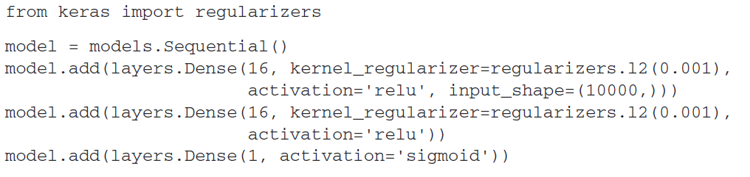
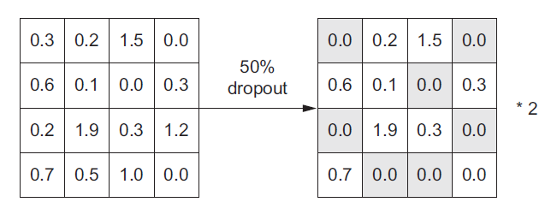
Overfitting avoidance
Take more data
Reduce the network size
Regularization (L1, L2)
Dropout

Slide 19
The universal workflow of machine learning
Defining the problem and assembling a dataset
Choosing a measure of success
Deciding on an evaluation protocol
Maintaining a hold-out validation set
Doing K-fold cross-validation
Doing iterated K-fold validation
Preparing your data
Developing a model that does better than a baseline
Last-layer activation
Loss function
Optimization configuration
Scaling up: developing a model that overfits (add layers, make layers bigger, train more epochs)
Regularizing your model and tuning your hyperparameters
Notes:
1. problem. Is it binary classification? Multiclass classification?
Scalar regression? Vector regression? Multiclass, multilabel classification?
Something else, like clustering, generation, or reinforcement learning? nonstationary problems: clothes seasons; memorize patterns that
are present in your training data.

Slide 20
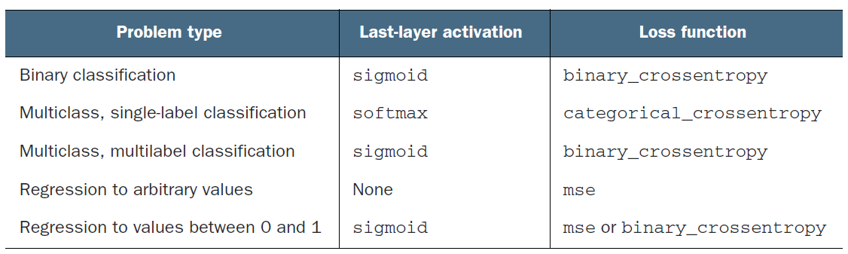
Last-layer activation

Slide 21
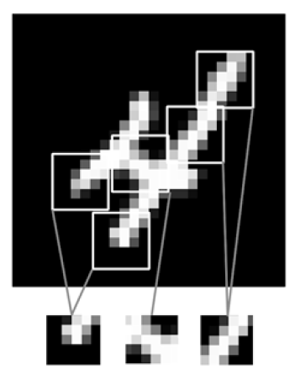
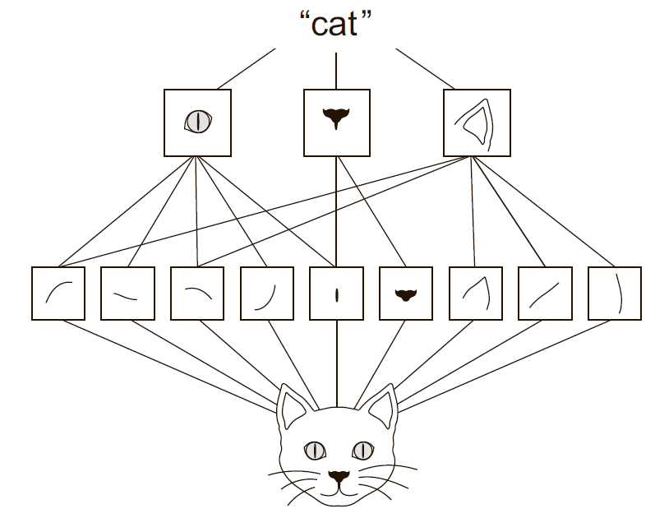
Deep Learning. Convolution
The patterns they learn are translation invariant.
They can learn spatial hierarchies of patterns

Slide 22
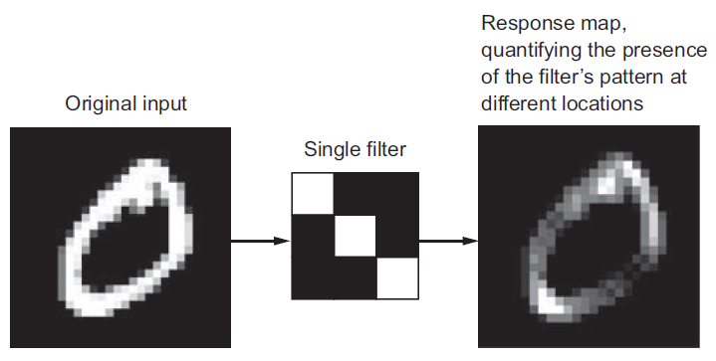
Convolution properties
Size of the patches extracted from the inputs—These are typically 3 × 3 or 5 × 5. In the example, they were 3 × 3, which is a common choice.
Depth of the output feature map—The number of filters computed by the convolution. The example started with a depth of 32 and ended with a depth of 64.

Slide 23
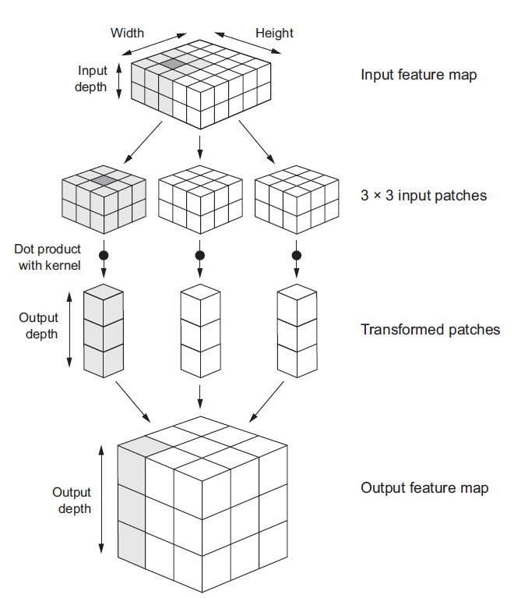
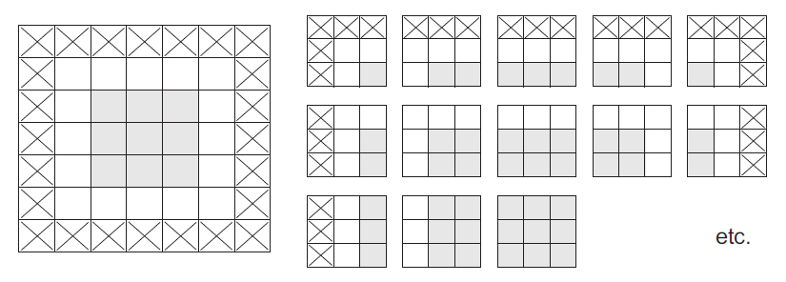
How it works?

Slide 24

MaxPooling

Slide 25
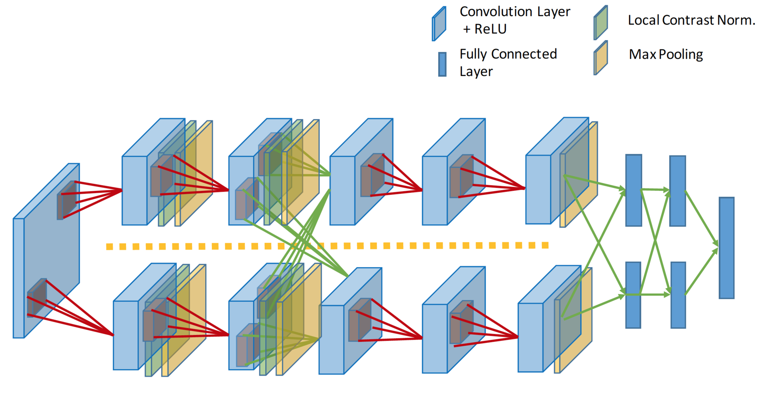
AlexNet (2012)

Slide 26
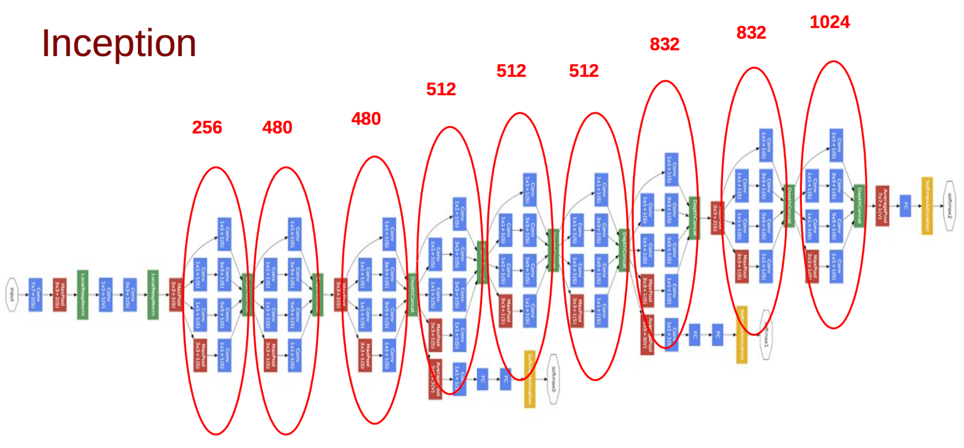
Inception от Google (17 Sep 2014)

Slide 27
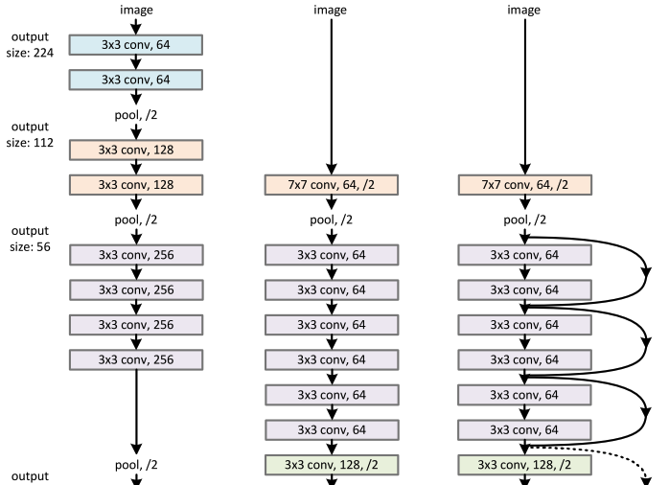
ResNET (10 Dec 2015)

Slide 28
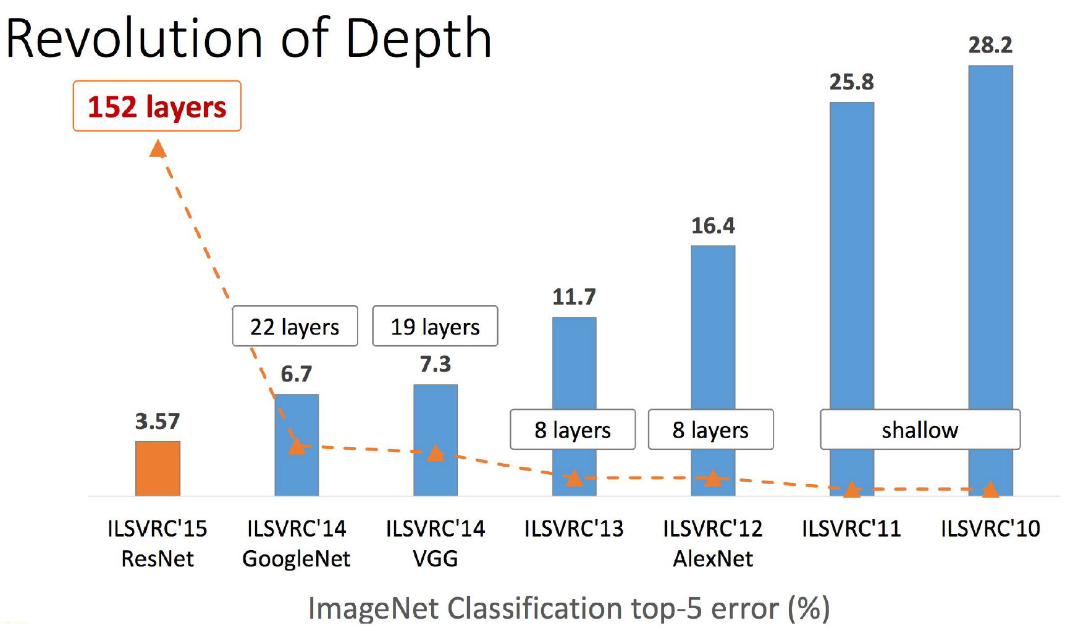
ResNET (10 Dec 2015)
Модель, с которой авторы победили на ImageNet, содержит меньше параметров, чем 19-слойный VGG, при глубине 152 слоя:

Slide 29
Word2vec

Slide 30
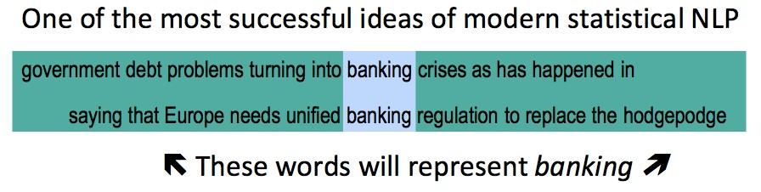
word2vec
Quoted after Socher

Slide 31
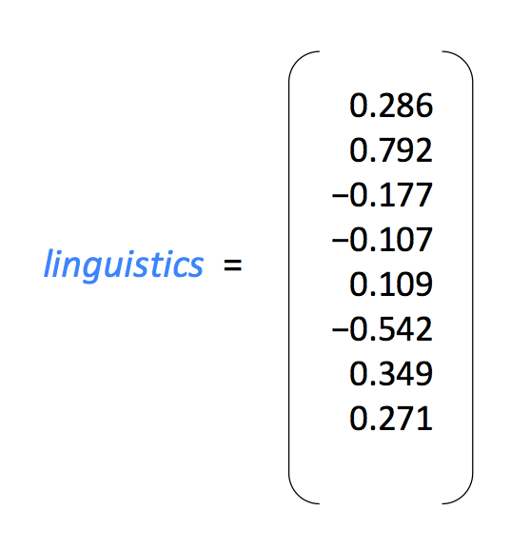
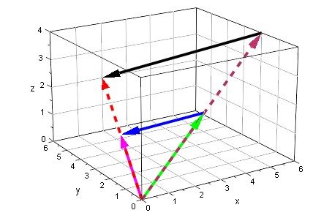
Quoted after Socher

Slide 32
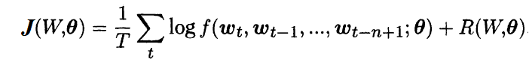
For each word from dictionary $ⅈ∈$V we associate a vector of features $w_{i}$(word embedding) size of $d,w_{i}∈ℝ^{d}$
i – word, c – context, $w_{c⋅1}, …, w_{c⋅n}$ – vector of words from context c

Slide 33
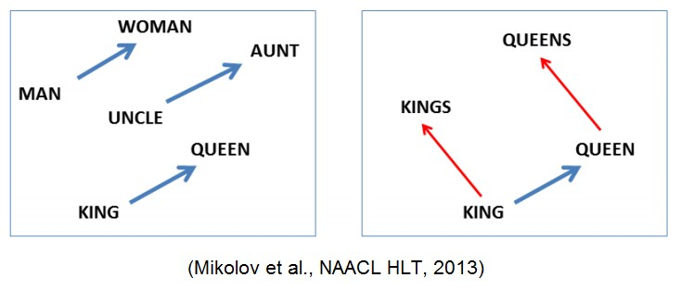
Vectors are directions in space Vectors can encode relationships

Slide 34
man is to woman as king is to ?

Slide 35
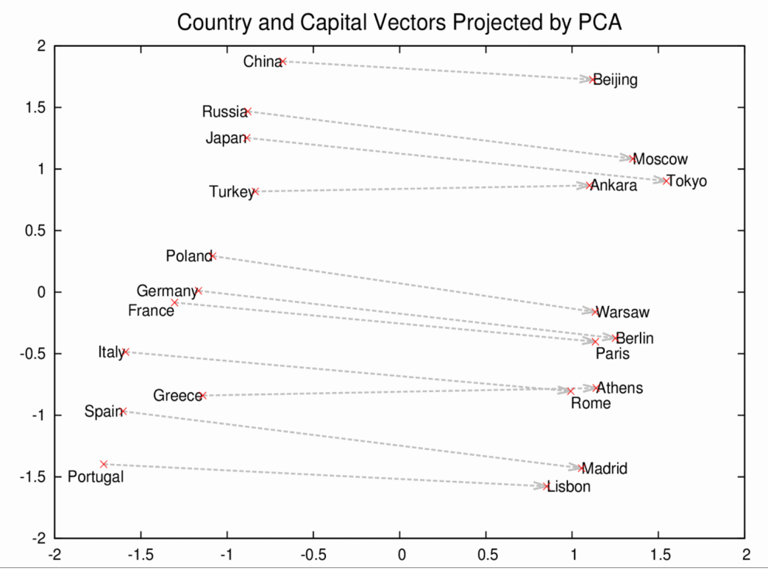

Slide 36
word2vec
•
by Mikolov, Sutskever, Chen, Corrado and Dean at Google
•
NAACL 2013
•
takes a text corpus as input
and produces the
word vectors as output

Slide 37
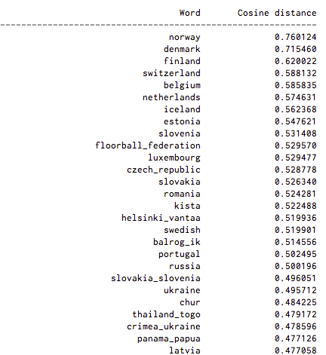
Sweden Similar words

Slide 38
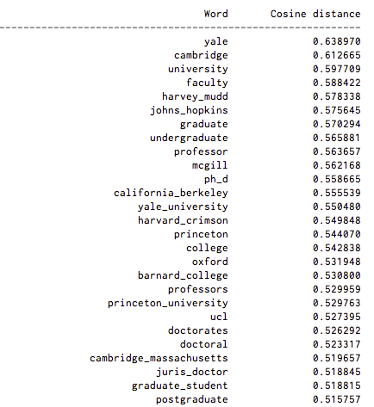
Harvard Similar words

Slide 39
word2vec
•
word meaning and relationships
between words are encoded spatially
•
two main learning algorithms in word2vec:
continuous bag-of-words and
continuous skip-gram

Slide 40
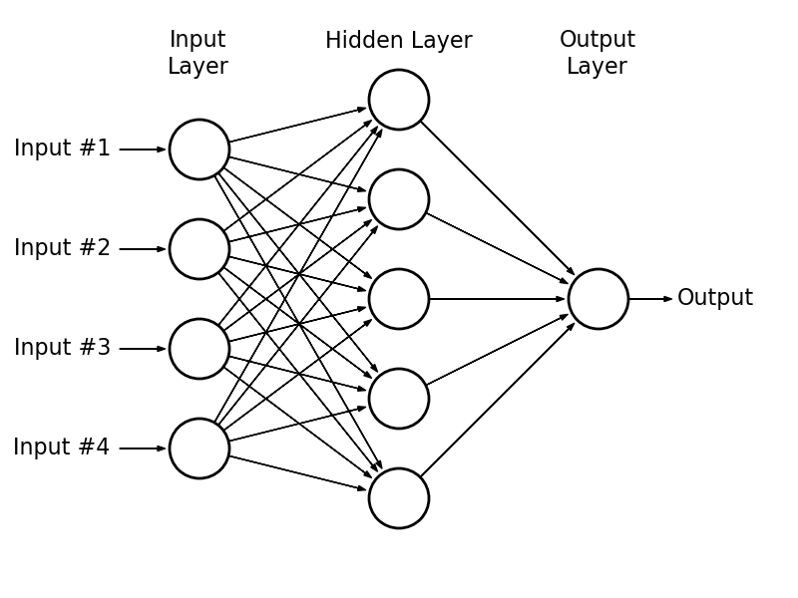
Goal

Slide 41
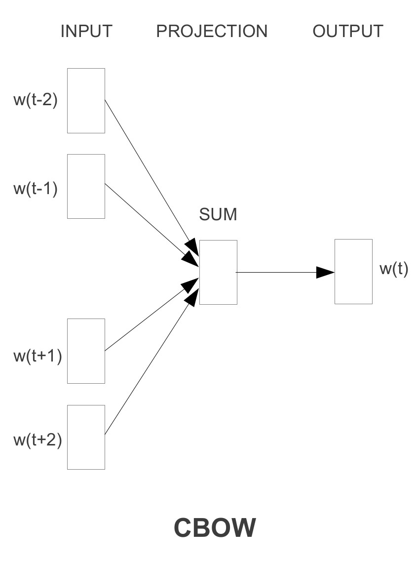
continuous bag-of-words
predicting the current word based on the context
order of words in the history does not influence the projection
faster & more appropriate for larger corpora
Mikolov et al.

Slide 42
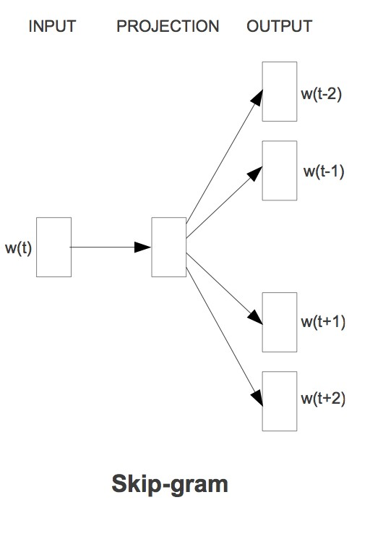
continuous skip-gram
maximize classification of a word based on another word in the same sentence
better word vectors for frequent words, but slower to train
Mikolov et al.

Slide 43
Why it is awesome
•
there is a fast open-source implementation
•
can be used as features
for natural language processing tasks and
machine learning algorithms

Slide 44
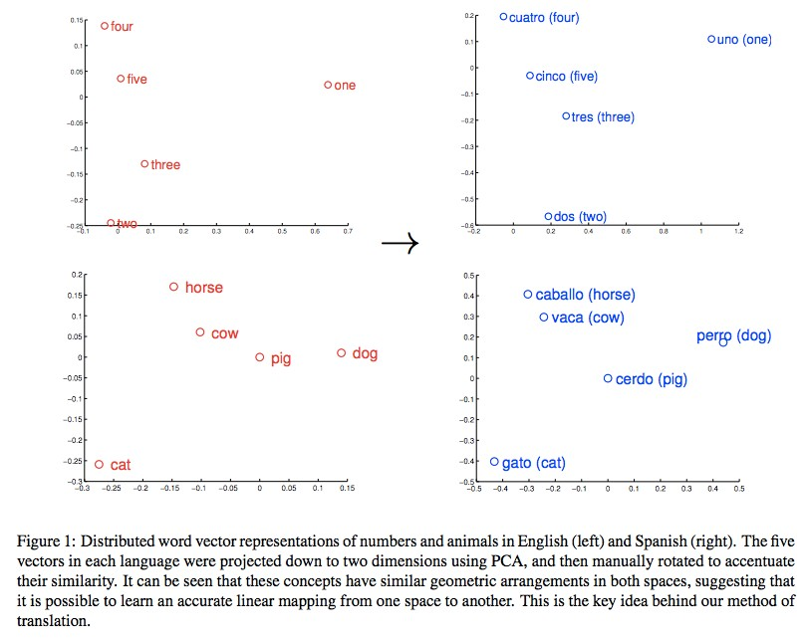
Machine Translation
Quoted after Mikolov

Slide 46
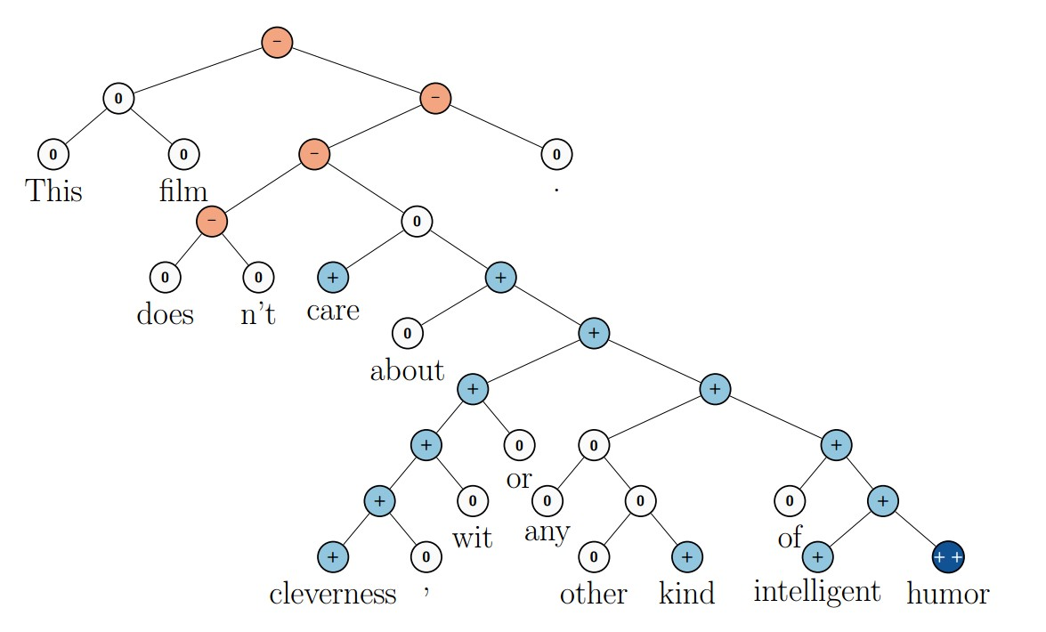
Sentiment Analysis
Recursive Neural Tensor Network
Quoted after Socher

Slide 47
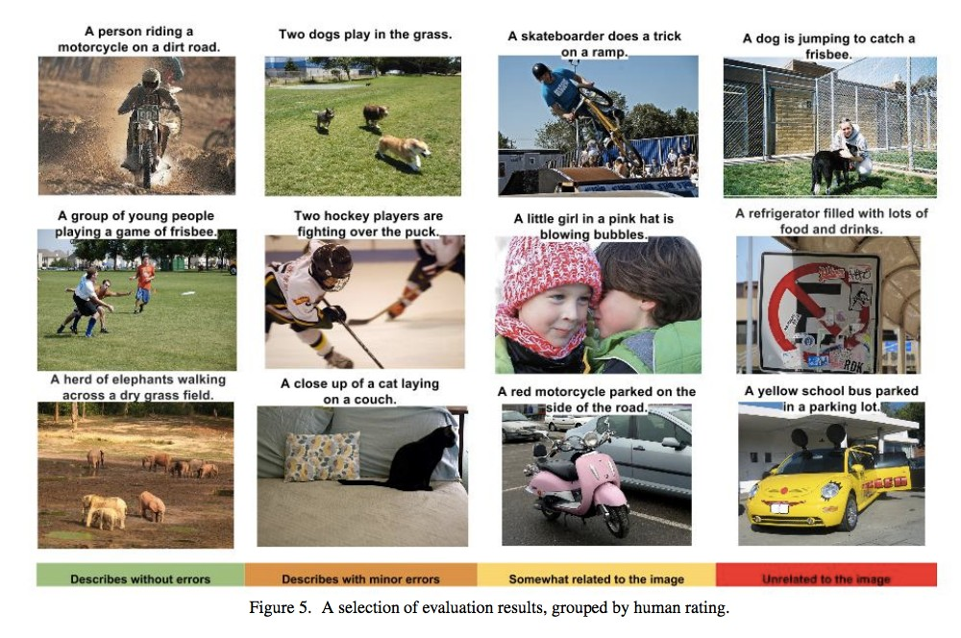
Image Descriptions
Quoted after Vinyals

Slide 48
Using word2vec
•
Original: http://word2vec.googlecode.com/svn/trunk/
•
C++11 version: https://github.com/jdeng/word2vec
•
Python: http://radimrehurek.com/gensim/models/ word2vec.html
•
Java: https://github.com/ansjsun/word2vec_java
•
Parallel java: https://github.com/siegfang/word2vec
•
CUDAversion: https://github.com/whatupbiatch/cuda-word2vec
Quoted after Wang

Slide 49
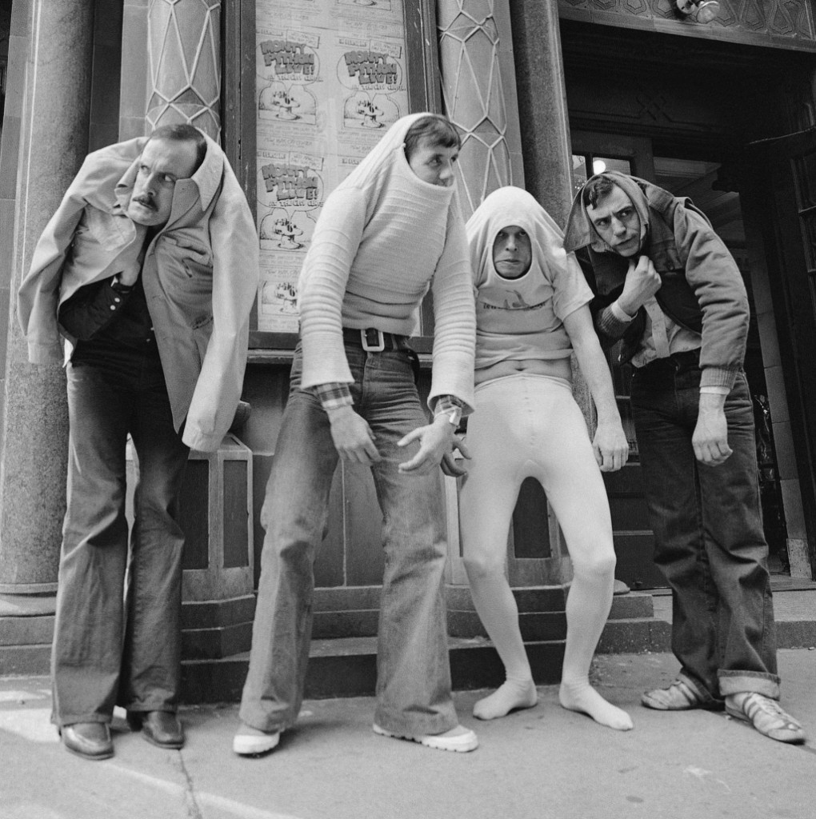
Using it in Python

Slide 50



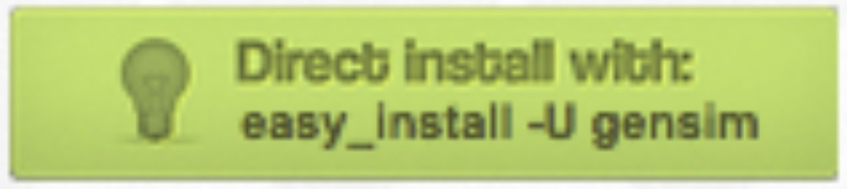
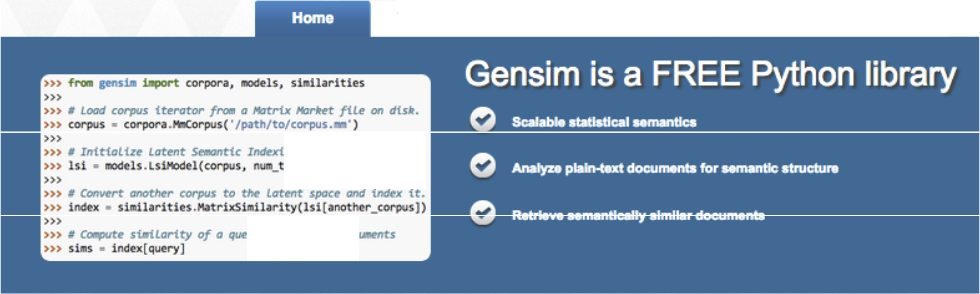








Tutonals
lnstall
Support
API
About
ng th 2вв d nstons.
_ ОС) с 200)
ry vs. indexed doc
eatures
Hover your mouвe over евсh feвlure for mo,e ln fo.
Scalabllity
Platform independent
Robust
Open source
Efficient implementa ions
Converters & 1/0 tormats
Similarity queries
Support

Slide 51
Recurrent Neural Network (RNN)

Slide 52
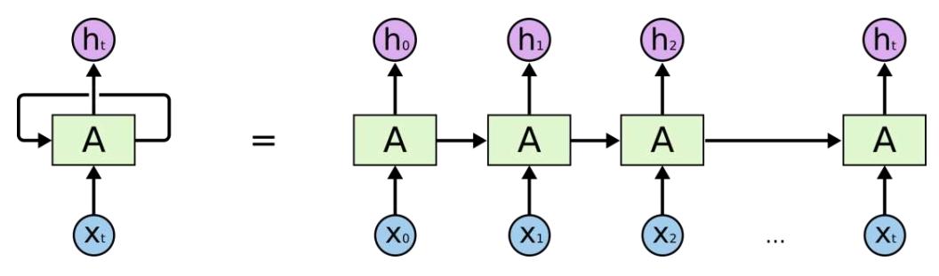

Slide 53

Benefits
Deal with sequential information
Perform the same task for every element of a sequence
Has memory
Can be unrolled like a chain

Slide 54


Application
Language Modeling and Generating Text
Machine Translation
Speech Recognition
Generating Image Descriptions

Slide 55

Training
Backpropagation Through Time (BPTT)

Slide 56



Variations
Bidirectional RNNs
Deep (Bidirectional) RNNs
LSTM networks

Slide 57
Long Short Term Memory Network (LSTM)

Slide 58


Slide 59


Memory Problem of RNN
Sometimes we need more context
RNN is unable to connect the information further in the past

Slide 60
Benefits of LSTM
Can learn long-term dependencies

Slide 61


Difference between RNN & LSTM
RNN: single layer (tanh)
LSTM: four interactive layers

Slide 62

Cell state
The conveyor belt

Slide 63

Gates (3 in total for LSTM)
A way that let information through
E.g. A sigmoid neural net layer & a pointwise multiplication operation

Slide 64


Optional Math – Sigmoid function

Slide 65

Step 1: Forget Gate Layer
Decide what info to throw away
Look at h[t-1] and x[t] and output a number 0~1 to decide how much cell state to keep C[t-1]
E.g. When see a new subject, we want to forget the gender of the old subject

Slide 66

Step 2: Input Gate Layer
Decide what info to add
A sigmoid: decide which value to update
A tanh layer: create a new candidate value C~[t]
E.g. add a new gender of the new subject

Slide 67

Step 3: Combine step 1 & 2
Combine step 1 & 2
Multiply the old state by f[t]: to forget the things
Add i[t] * C~[t] : to add new candidate value (scaled)

Slide 68
Step 4: Filter/output the Cell state
Decide what to output
sigmoid: decide which part to output
tanh: push the value to be between -1 ~ 1
Multiply them to only output the part we decided to
E.g. output a info related to a Verb
E.g. output whether the subject it singular or plural

Slide 69

Step 4: Filter/output the Cell state
Decide what to output

Slide 70

Variants on LSTM (1)
Peephole:
let the gate layer look at the cell state (entire/ partial)

Slide 71

Variants on LSTM (2)
Coupled forgot and input gates:
Not deciding separately
 f[t] * C[t-1] + (1-f[t]) * C~[t]

Slide 72

Variants on LSTM (3)
Gated Recurrent Unit (GRU):
combine the forget and input layer into a single “update gate”
merge the cell state and the hidden state
simpler and popular

Slide 73
RNN / LSTM Effectiveness

Slide 74

Multiple types of RNN use cases

Slide 75
Turing-Complete
Running a fixed program with certain inputs and some internal variables (can simulate arbitrary programs)
Andrej Karpathy (Ph.D. @ Stanford):

Slide 76
Non-sequential data
Though the data is not in form of sequences, we can still use RNN by process it sequentially.

Slide 77
Some cool RNN/LSTM applications
http://karpathy.github.io/2015/05/21/rnn-effectiveness/

Slide 78
Great references
[1] RNN: http://www.wildml.com/2015/09/recurrent-neural-networks- tutorial-part-1-introduction-to-rnns/?subscribe=success#blog_subscription-2
[2] LSTM: http://colah.github.io/posts/2015-08-Understanding-LSTMs/
[3] RNN Effectiveness: http://karpathy.github.io/2015/05/21/rnn- effectiveness/
[4] Backpropagation: http://cs231n.github.io/optimization-2/#backprop
[5] ML categories: http://enhancedatascience.com/2017/07/19/machine- learning-explained-supervised-learning-unsupervised-learning-and- reinforcement-learning/

